Slide 1

Automobile Insurance Fraud Detection
Lakshmi Mounika Bolisetti
Oam Chandra Laasya Tummala
Vijay Kumar Pulavarthi
Roshan Erukulla

Slide 2


Introduction
The insurance industry faces significant challenges in detecting fraudulent claims. Fraudulent claims can lead to substantial financial losses.
By accurately identifying potentially fraudulent claims, insurance companies can optimize their resource allocation, reduce financial losses, and maintain fair pricing for legitimate policyholders.
This project aims to develop a machine learning model to predict the likelihood of fraud in insurance claims using various features such as policy details, accident circumstances, and demographic information.

Slide 3

Problem Statement
Insurance fraud poses a significant challenge to the industry, resulting in substantial financial losses and increased premiums.
Auto insurers alone lose billions annually due to practices like unrecognized drivers and false garaging, leading to premium leakage.
Fraudulent claims drive up the cost of insurance premiums for all policyholders, as insurers compensate for the losses incurred due to fraud by raising premiums across the board.
Effective fraud detection strategies are essential to mitigate these challenges and protect the integrity of the insurance system.

Slide 4
Key Objectives:
Cleaning and preprocessing the data
Perform Exploratory data analysis
Explore various machine learning algorithms (e.g., Random Forest, Logistic Regression, SVM)
Evaluate model performance using appropriate metrics (e.g., accuracy, AUC ROC, F1 score, Recall and Precision)
Build a predictive model to classify insurance claims as fraudulent or non-fraudulent using the best model.

Slide 5
Data Description
The dataset encompasses a diverse array of features encompassing policy particulars, accident specifics, and demographic data.
These features include details such as the month, week, and day of the accident, the make of the vehicle involved, the area where the accident occurred, and demographic factors like the gender and marital status of the policyholder.
Additionally, it encompasses attributes like the age of the policyholder, fault attribution, insurance policy type, vehicle category, and whether fraud was detected in the claim.
The focal point of analysis in this dataset is the target variable "FraudFound_P”, which serves as an indicator of potentially fraudulent claims.
A significant portion of the dataset comprises categorical data, preprocessing steps such as encoding or transformation are imperative to facilitate meaningful analysis and model training.

Slide 6
Steps for data preprocessing
1) Handling Missing Values:
Dropping rows with missing values using the “dropna” method
Replacing specific values with appropriate ones based on predefined conditions
2) Numeric Value Extraction:
Extracting numerical values represented as strings in certain columns using regular expressions
Converting extracted values into actual numeric data types suitable for analysis
3) Filtering and Dropping Columns:
4) Encoding Categorical Variables:
Filter and drop unnecessary columns from the dataset to streamline the analysis process and remove redundant information.
Use techniques such as StringIndexer and OneHotEncoder to encode categorical variables into numerical representations.
This encoding is essential as many machine learning algorithms require numerical inputs.
5) Feature Vector Assembly:
Assemble feature vectors for modeling using VectorAssembler.
Consolidate numerical and encoded categorical variables into a unified feature vector suitable for feeding into machine learning algorithms.

Slide 7
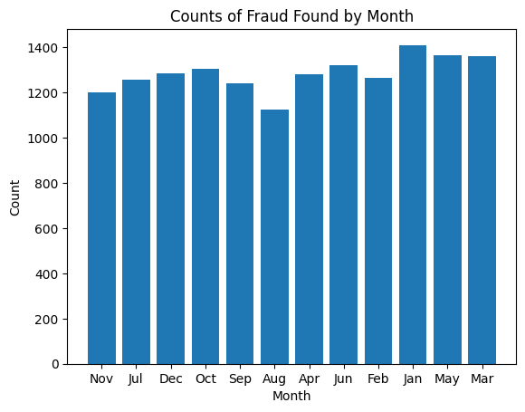
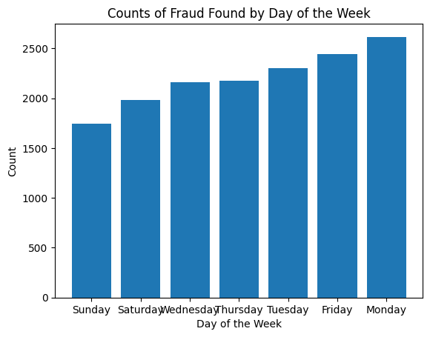
Results - Exploratory Data Analysis (EDA)

Slide 8
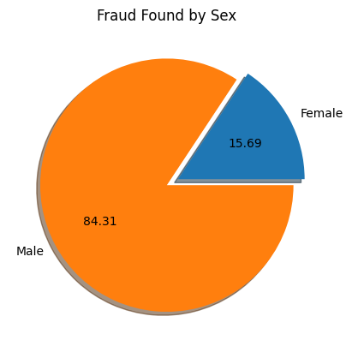
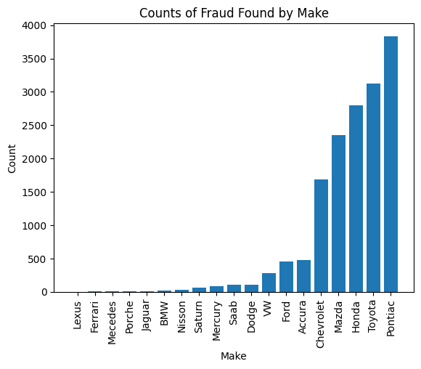
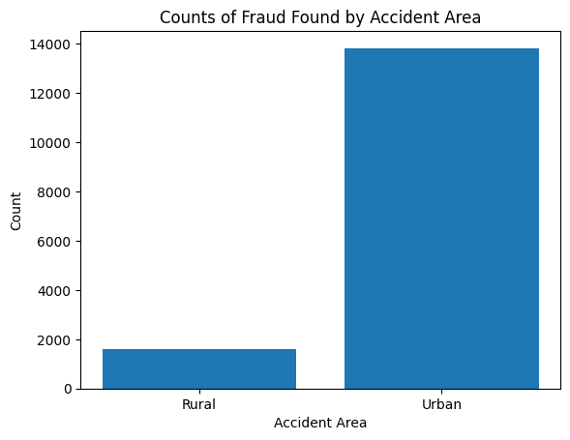
EDA continued ….

Slide 9
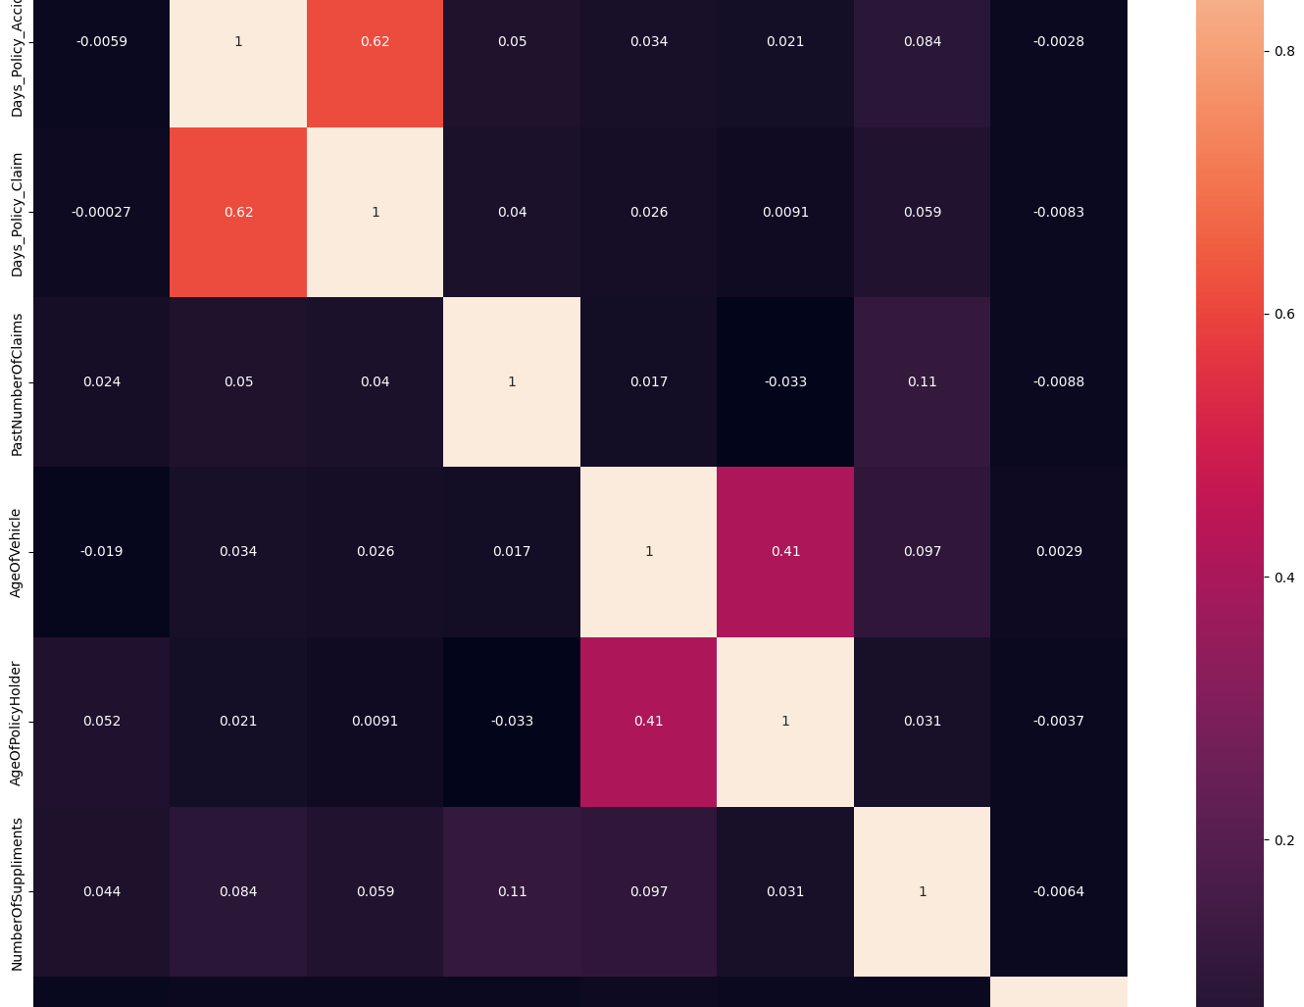
Correlation matrix
By visualizing the correlation matrix, you can quickly identify:
Strong positive correlations (values close to 1): Variables that increase together.
Strong negative correlations (values close to -1): Variables that decrease together.
Weak correlations (values close to 0): Variables that don't have a strong linear relationship.

Slide 10
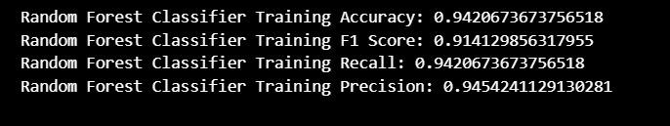
MODEL TRAINING AND EVALUATION
1. Random Forest Classifier:
Define the Random Forest classifier with specified parameters (e.g., number of trees, maximum depth, feature selection strategy).
Train the model on the training dataset. Generate predictions for the training dataset.
Evaluate the model's performance using accuracy as the evaluation metric.
Utilize PySpark's ClassificationEvaluator to calculate the accuracy of the model's predictions on the training data.

Slide 11
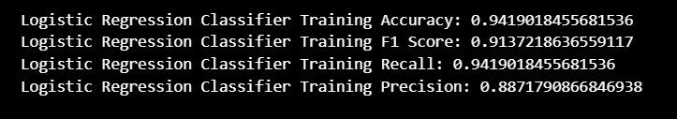
MODEL TRAINING CONTD…..
2. Linear Regression:
- Define the Linear Regression model with specified parameters, including the features and label columns.
- Train the model on the training dataset (`train_df`) using the `fit()` method.
- Estimate the coefficients for the logistic function based on the input features and labels.
- Generate predictions on the training dataset to assess the model's performance.
- Evaluate the model performance using model metrics.

Slide 12
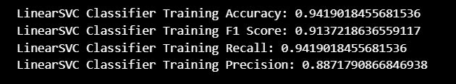
MODEL TRAINING CONTD …..
3. Linear (Support Vector Mechanism)SVM:
- Implement the Linear SVM method with the same methodology as in the Linear Regression model.
- Train the model on the training dataset.
- Evaluate the model's performance using model metrics.

Slide 13
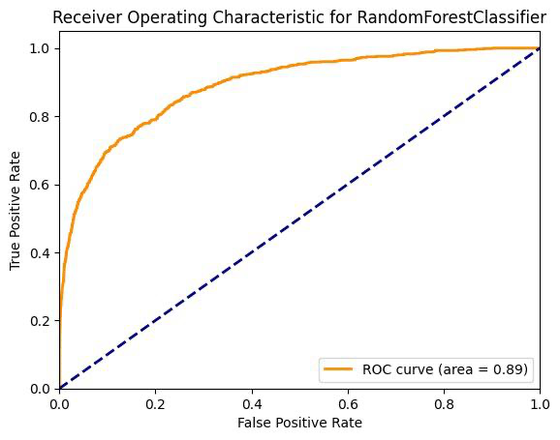
BEST MODEL SELECTION
Random Forest classifier outperformed Logistic Regression and Linear SVM in terms of both training and test accuracy, achieving approximately 94.21% and 93.70%, respectively.
The Random Forest model demonstrated consistent performance across both datasets, indicating minimal overfitting.
The ensemble nature of Random Forest allows it to capture complex interactions and nonlinear relationships within the data, resulting in more robust predictions compared to Logistic Regression and Linear SVM.
Random Forest classifiers are less sensitive to outliers and noise, making them suitable for classification tasks where accuracy and generalization are crucial, such as insurance fraud detection.

Slide 14

Model Prediction
The trained Random Forest classifier is utilized to predict whether a claim is fraudulent or not by applying it to the input data.
Predictions are generated based on the trained model, and probabilities are obtained for each instance.
A threshold is then applied to these probabilities to convert them into binary predictions, where a value of 1 indicates a fraudulent claim and 0 indicates a non-fraudulent claim.
The binary predictions are displayed, with a value of 1 suggesting a potentially fraudulent claim. This demonstrates the effectiveness of the Random Forest classifier in identifying patterns and making accurate predictions for fraud detection tasks.

Slide 15
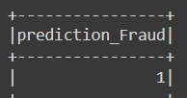
Example input and output
# Sample input data for testing
input_data = [[10, 2, 5, 2, 11, 2, 1, 1]]
# Define the schema for input data
schema = StructType([
StructField("Month", IntegerType(), True),
StructField("WeekOfMonth", IntegerType(), True),
StructField("DayOfWeek", IntegerType(), True),
StructField("DayOfWeekClaimed", IntegerType(), True),
StructField("MonthClaimed", IntegerType(), True),
StructField("WeekOfMonthClaimed", IntegerType(), True),
StructField("Sex", IntegerType(), True),
StructField("MaritalStatus", IntegerType(), True)
])

Slide 16

Any questions

Slide 17

THANK YOU

